Slide 1


REAL-TIME IOT-BASED
COLD CHAIN MONITORING & PREDICTIVE ANALYTICS
Page 01
INTEGRATING SENSOR NETWORKS, MACHINE LEARNING, AND
MATHEMATICAL MODELS FOR VACCINE & FRUIT STORAGE SAFETY
InnovAct 2025
Track: IoT Based Technologies
Innovation ID: IR2025-996042

Slide 2
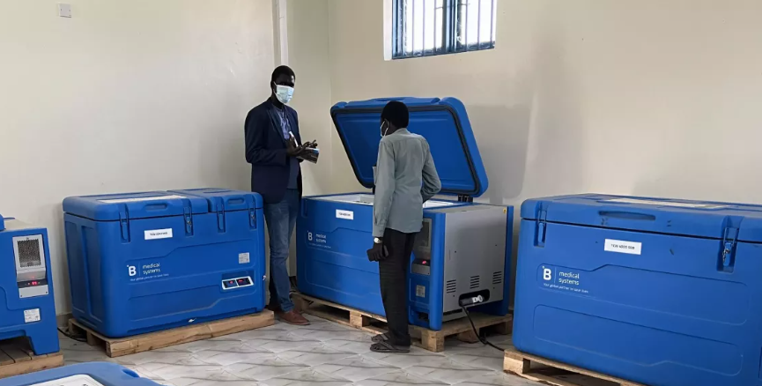

PROBLEM STATEMENT
Page 02
Maintaining cold chains for vaccines, medicines, and fresh produce is vital, as even small deviations cause spoilage, health risks, and financial losses.
Globally, 25–50% of vaccines are wasted due to poor management, and despite major investments by Gavi and COVAX, reliability remains a challenge.
In India there are 28,000 cold chain points nationwide. However, 10–15% of vaccines is spoilt annually, with wastage reaching 27% for DPT and 61% for BCG. 18–20% of fruits and vegetables are lost post-harvest.

Slide 3
PROPOSED SOLUTION
Page 03
We propose a hybrid IoT–Maths–ML platform that predicts spoilage risk and explains why it happens. It also provides the optimum shortest path for transportation.
IoT sensors capture temperature, humidity, gas levels, and door events in real time.
Physics-informed mathematical models (spoilage kinetics, entropy trends) reveal interpretable degradation dynamics - offering insights that black-box ML alone cannot.
ML models complement this by integrating multiple signals to yield calibrated spoilage probabilities.
Visualization & alerts allow proactive interventions, reducing vaccine and food wastage while ensuring safety.

Slide 4
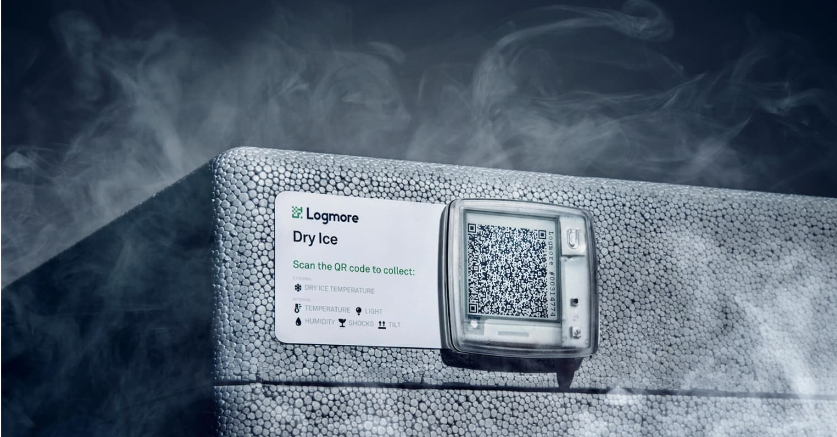
Page 04
TECHNICAL APPROACH
IoT Data Acquisition:
Deploy DHT, MQ-135, and water-level sensors.
Capture real-time telemetry: temperature, humidity, gas levels.
Mathematical & Physics-Based Modeling:
Compute spoilage rates using Q₁₀ kinetics.
Detect anomalies using z-score and EWMA filters.
Provides interpretable failure-time predictions beyond black-box ML.
Machine Learning Layer:
Supervised models (Random Forest) combine multiple cues.
Output calibrated spoilage probability for actionable decision-making.
Integration & Visualization:
Real-time dashboards & alerts.
Suggest corrective actions: rerouting, optimum routes, cold storage, or intervention.

Slide 5
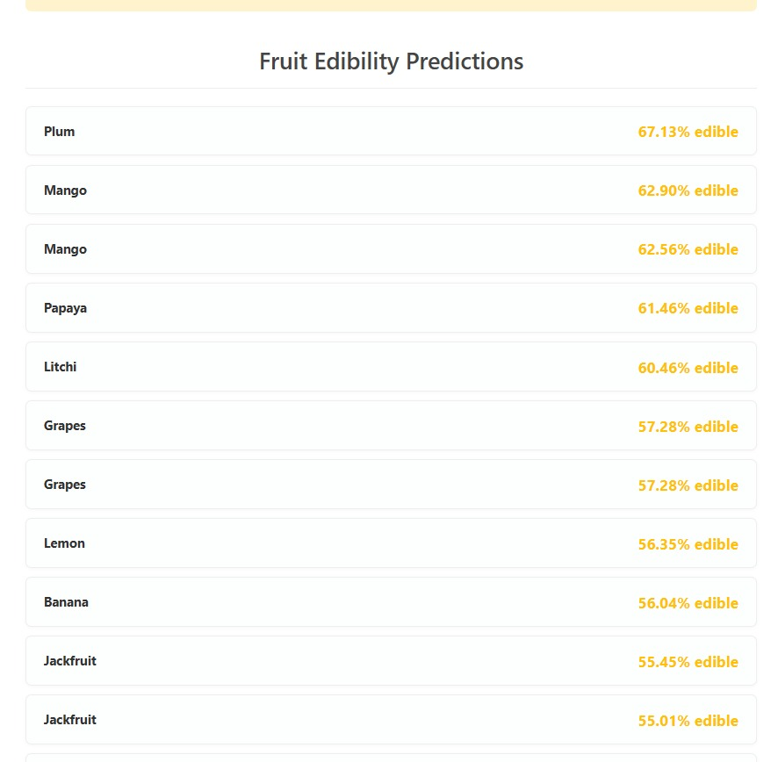
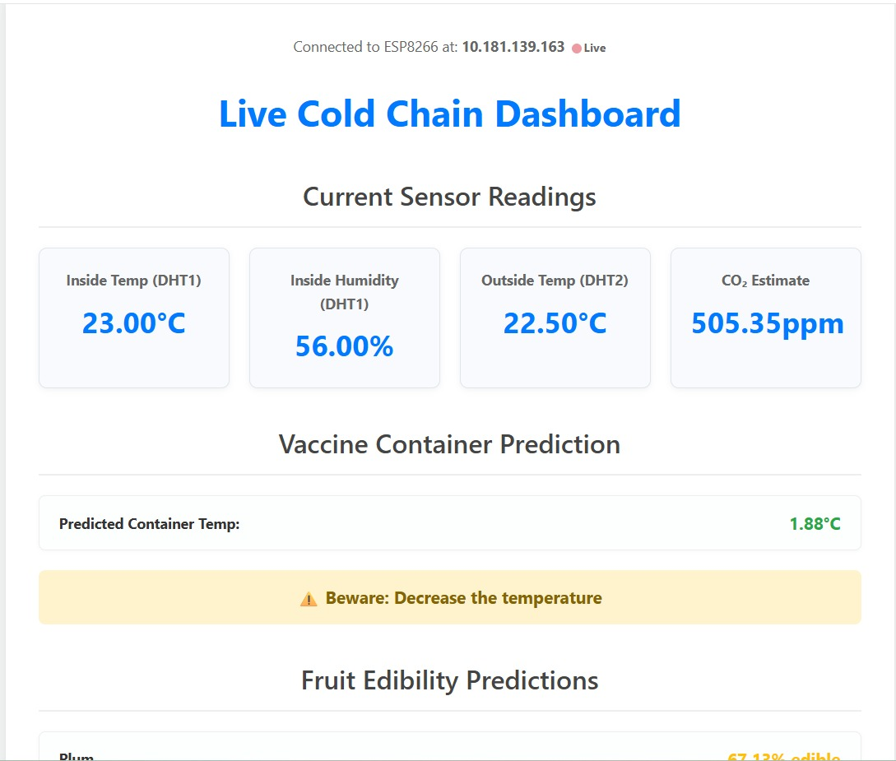
DEMO/PROTOTYPE
Page 05 (a)

Slide 6
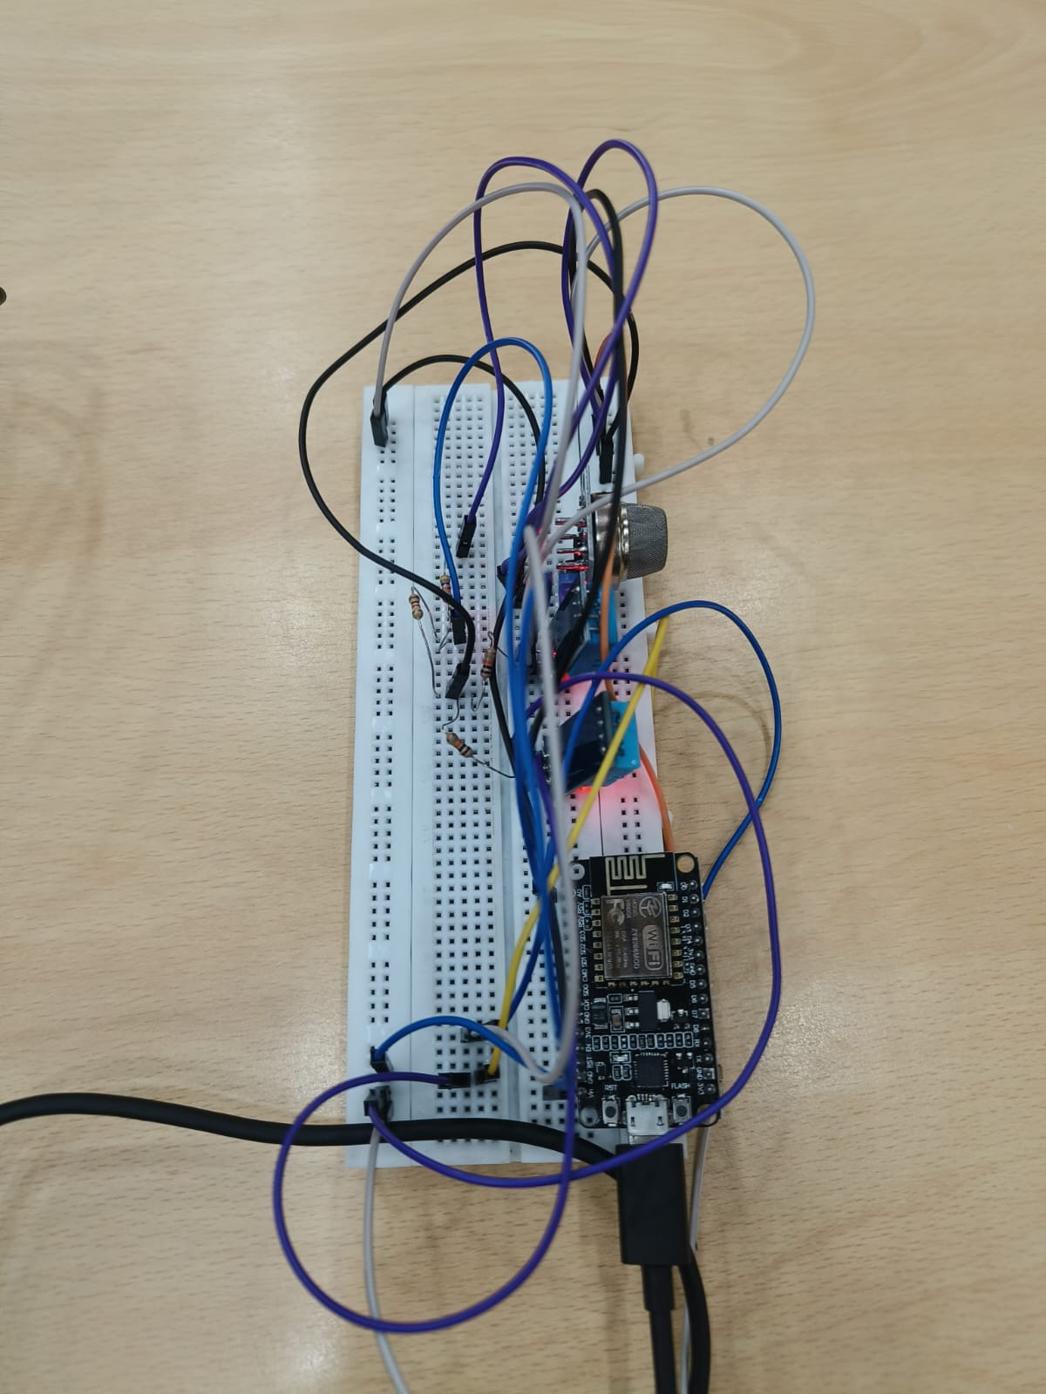
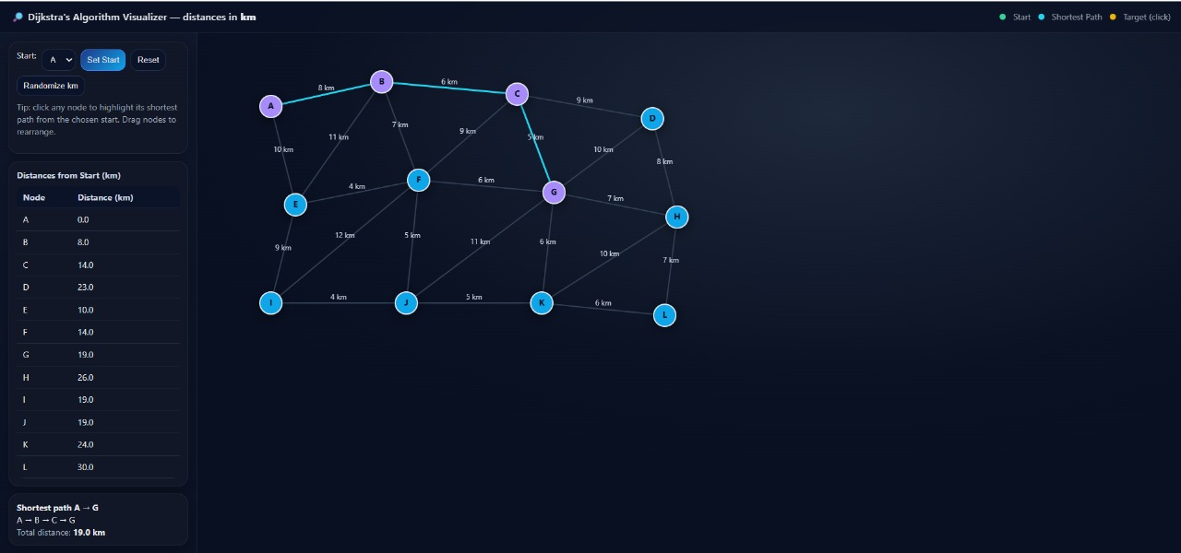
DEMO/PROTOTYPE
Page 05 (b)

Slide 7

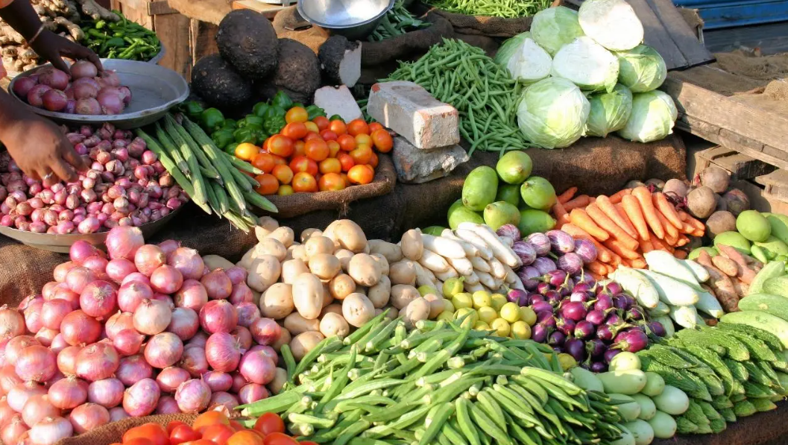

Page 06
IMPACT AND USE CASES
Who benefits:
Pharma distributors, FPOs, kirana-linked cold storages
Healthcare systems: preserve vaccine potency, reduce re-vaccination costs.
Food distribution: minimize spoilage of dairy, seafood produce.
Logistics operators: optimize routing and storage.
Governments & NGOs: ensure equitable delivery in remote areas.

Slide 8
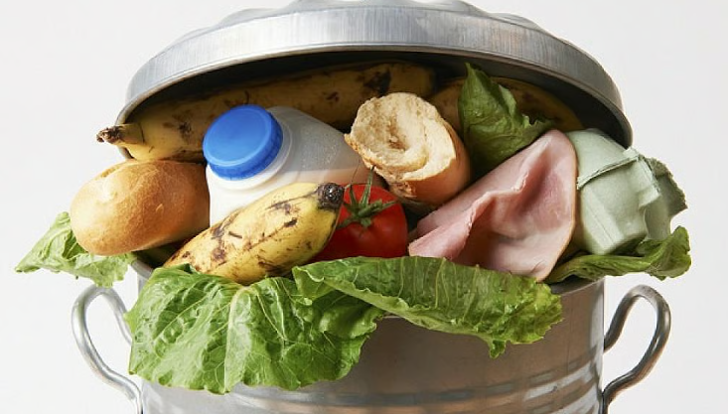

IMPACT AND USE CASES
Page 07
Real-world applications:
Vaccine programs in LMICs to cut 25–50% waste.
Environmental impact reduction by lowering cold storage energy & waste (40% of India’s food gets spoiled in the supply chain).
Integration with systems like Gavi and Nexleaf which underscore the need for live data in cold chain.
Scalability & Sustainability:
Demo can be upscaled. Physics-informed model ensures effectiveness even with limited training data.
Opens path to integration with logistics APIs, remote rural deployment via mobile networks, and sustainable optimization.

Slide 9
CHALLENGES FACED
Page 08
Scarcity of Labeled Spoilage Data
Limited ground truth; reliance on physics-based models.
Sensor Noise and Drift
Fluctuations in readings requiring calibration and smoothing.
Product-Specific Variability
Different perishables have unique spoilage thresholds.
Data Latency or Loss
Telemetry gaps affecting real-time monitoring.
Calibration of Physics Models
Accurate Q₁₀ indices need experimental validation.
Alert Threshold Tuning
Balancing early warnings and false alarms.
Regulatory Compliance
Ensuring adherence to local cold-chain standards.

Slide 10

FUTURE SCOPE
Page 09
Integrate with AI-driven route optimization to minimize exposure during transit.
Expand physics-informed models using additional sensor data (vibration, light, gas composition).
Enable blockchain-based secure logging for tamper-proof audit trails.
Connect with national cold-chain and immunization networks for centralized monitoring.
Incorporate predictive energy management and sustainable cold storage solutions.

Slide 11
CONCLUSION
Page 10
Our platform transforms cold-chain monitoring by integrating real-time telemetry with physics-informed spoilage models, anomaly detection, and ML-based predictions. Unlike purely black-box approaches, it provides interpretable insights into why spoilage may occur, enabling proactive interventions, reducing waste, and ensuring product safety with transparent, actionable intelligence.

Slide 12
Page 11
ACKNOWLEDGEMENTS
Lakshay Chauhan -23BCE0644
Raghav Krishna-23BEC0191
Krish Sinha-23BEC0280
Tanisha Choudhuri-23BML0081
Prajjit Basu-23BDS0067

Slide 13
THANK YOU

